Slide 1
ECE808: Smart Water Systems using the EPANET-MATLAB Toolkit
Demetrios ELIADES, PhD (@eldemet)
Research Assistant Professor
KIOS Research and Innovation Center of Excellence
University of Cyprus

Slide 2
Content Contributors
Stelios VRACHIMIS, PhD
Research Associate
(@SteliosVr)
Marios KYRIAKOU
Research Software Engineer (@Mariosmsk)
Pavlos PAVLOU
Research Engineer
(@Ppavlo02)

Slide 3
Before we begin
Download
https://github.com/KIOS-Research/ece808-smart-water-systems
Unzip, copy files in your “work” folder (rename!)
Open folder in MATLAB
Run the command “mex –setup”

Slide 4

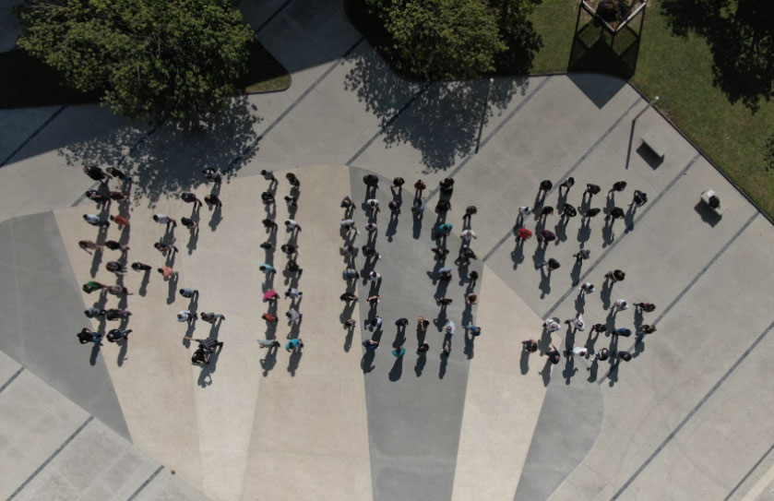
KIOS Research and Innovation Center of Excellence
Created in 2008, upgraded to CoE by the EU in 2017
Part of the University of Cyprus (UCY)​, 180+ staff
Strategic collaboration: ​UCY+Imperial College London​
KIOS Innovation Hub -> transitioning local Water Utilities to Smart Water Networks
MSc on Intelligent Critical Infrastructure Systems with ICL/UCY faculty​ (www.msccis.ucy.ac.cy)
Coordinating ERC SyG Water-Futures, H2020 PathoCERT and many others!

Slide 5
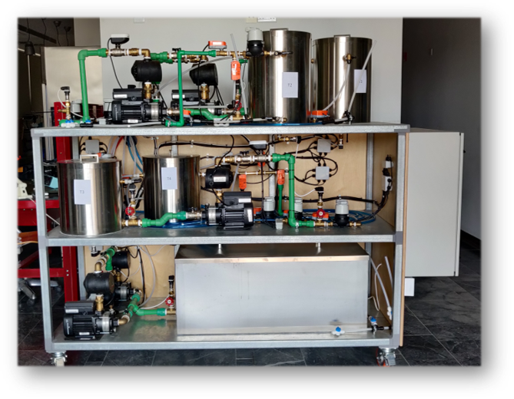
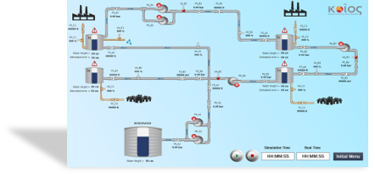
KIOS Smart Water Systems Team
Co-organized the “Battle of Leakage Detection and Isolation Methods” Competition (BATTLEDIM)
Released benchmarks
L-TOWN EPANET Model
Leakage Database (leakDB)
Water Security Testbed
KIOS Virtual City & Integrated Platform

Slide 6
Course structure
Introduction
General Functionality
Research applications
Advanced topics

Slide 7
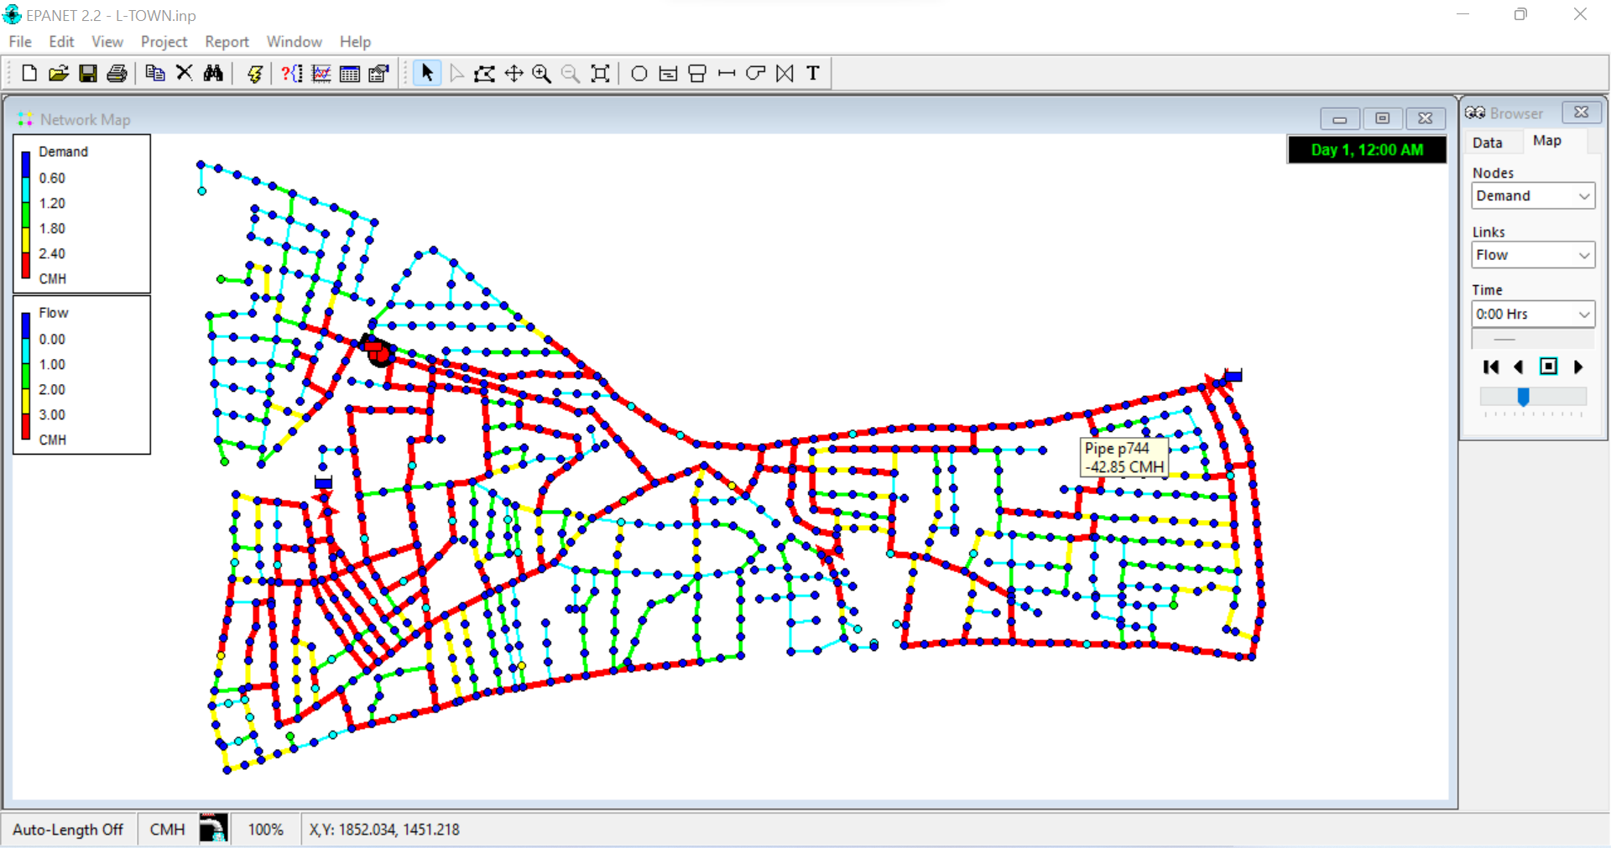
EPANET
Created by Lew Rossman
First version in 1993, Second in 2000.
Now EPA/OWA EPANET v2.2.0 (2020)
Hydraulic and quality simulator for water distribution systems
Gradient algorithm for hydraulics
Lagrangian method for computing the PDEs for quality
Simple graphical interface for simulations
Shared library for multiple OS
Salomons, E., Hatchett, S. and Eliades, D.G., 2018, July. The EPANET Open Source Initiative. In WDSA/CCWI Joint Conference Proceedings (Vol. 1).

Slide 8
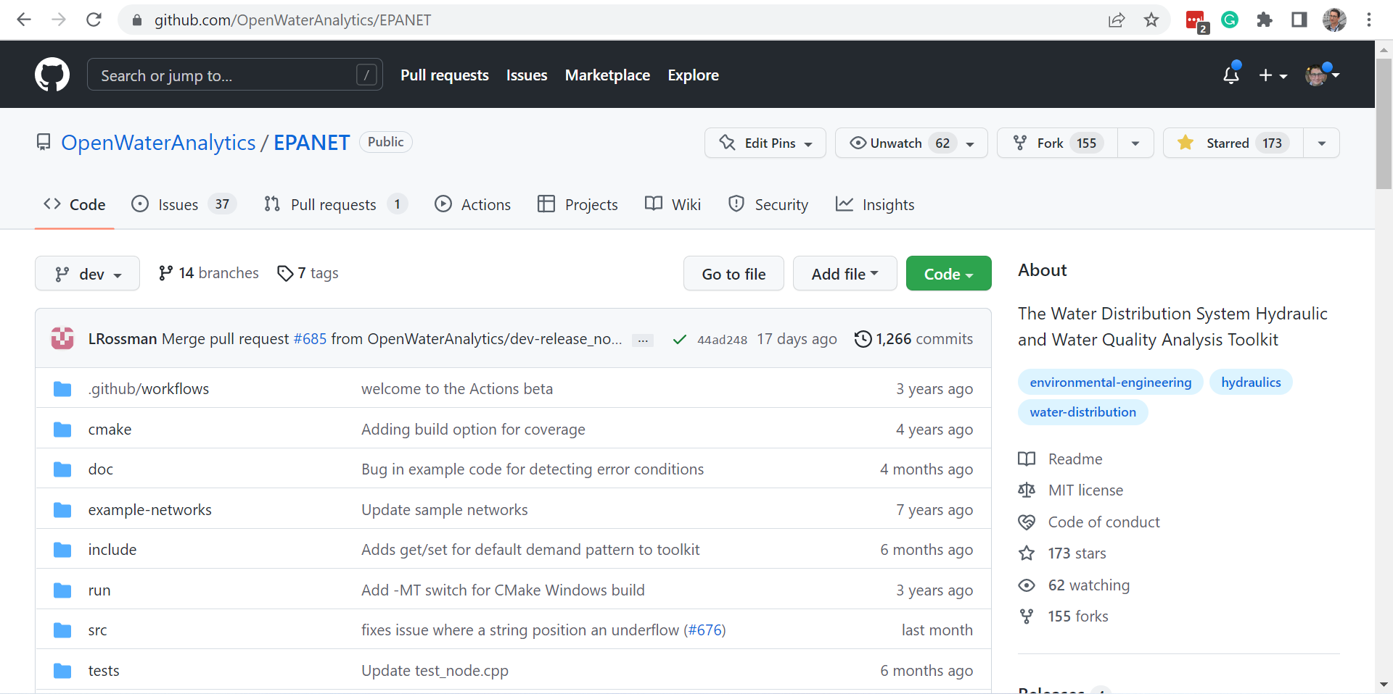
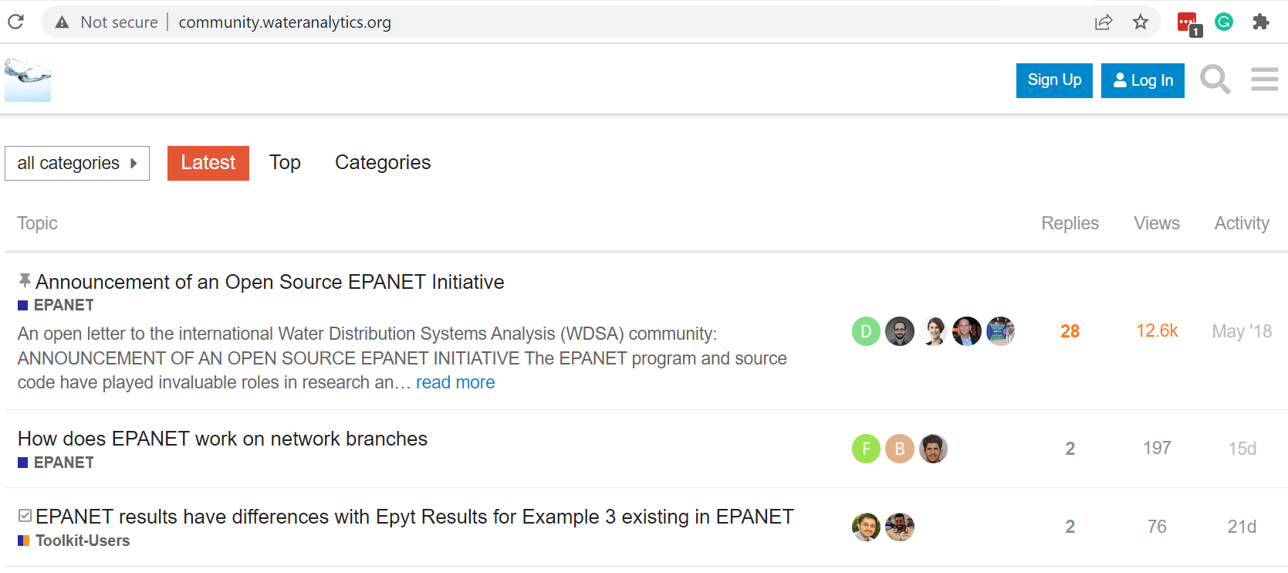
The OpenWaterAnalytics (OWA) Community
Open source community supports the development of EPANET since 2015 (kudos to Sam, Elad and Lew)
Established the OWA GitHub repository where EPANET is hosted and updated
https://github.com/OpenWaterAnalytics/
OWA Forums for Q&A
http://community.wateranalytics.org
OWA GitHub supports various tools in the EPANET ecosystem
Salomons, E., Hatchett, S. and Eliades, D.G., 2018, July. The EPANET Open Source Initiative. In WDSA/CCWI Joint Conference Proceedings (Vol. 1).

Slide 9
History of the EPANET-MATLAB Toolkit (EMT)
First version in 2009 as wrapper of EPANET library in MATLAB
Evolved to a MATLAB Class to provide additional capabilities
Development led by KIOS (Marios Kyriakou - @mariosmsk)
Supports EPANET and EPANET-MSX libraries, stand-alone execution
Simple intuitive language & syntax – no need to memorize
Open-source (European Union Public License v.1.2)
Includes a collection of 60+ benchmarks & 20+ examples
Supported through the OWA Forum
Version 2.2.1 includes almost 800 methods, 23K lines of code!
5K downloads in MathWorks
D.G. Eliades, M. Kyriakou, S. Vrachimis and M.M. Polycarpou, "EPANET-MATLAB Toolkit: An Open-Source Software for Interfacing EPANET with MATLAB", in Proc. 14th International Conference on Computing and Control for the Water Industry (CCWI), The Netherlands, Nov 2016, p.8. (doi:10.5281/zenodo.831493)

Slide 10
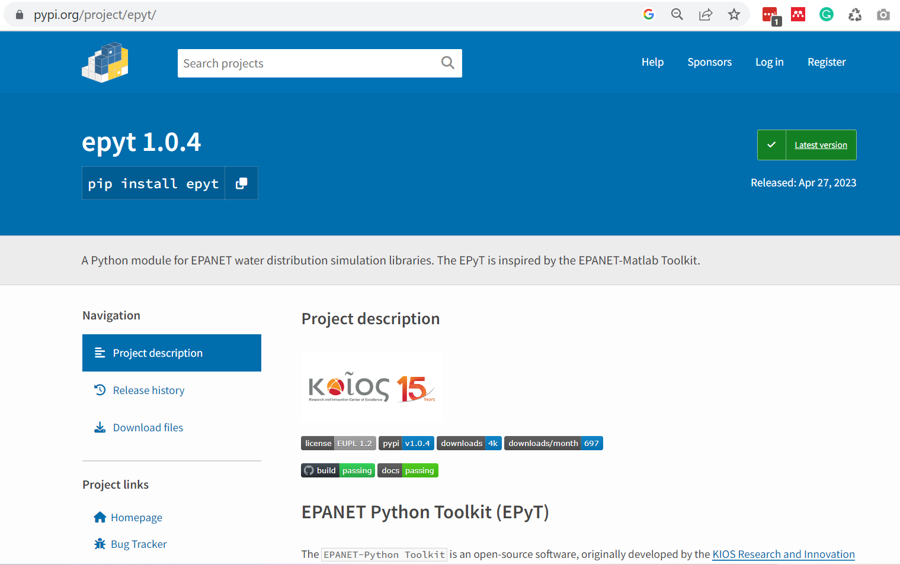
New! EPANET-Python Toolkit (EPyT)

Slide 11
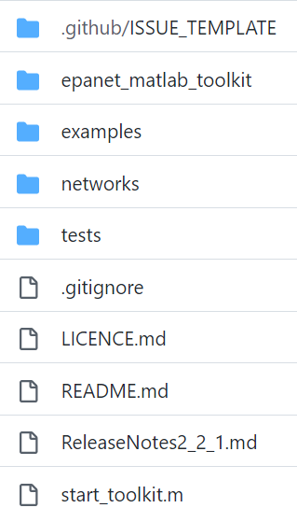
EMT Folder Structure
The EMT Class and libraries
Various Examples in MATLAB
60+ open benchmark networks
Unit-test functions
Load Toolkit

Slide 12


EMT Class and Libraries
epanet_matlab_toolkit/
32bit
64bit
glnx
mac
epanet.m

Slide 13
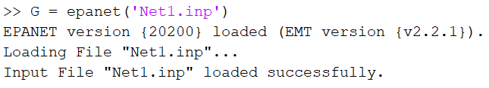
The epanet MATLAB Class
MATLAB Classes can “simplify programming tasks that involve specialized data structures or large numbers of functions that interact with special kinds of data.”
The epanet Class is a collection of properties and functions (but not for a specific network)
You can use one Class to create multiple Objects (specific networks)
G includes the Net1 topology and structural values, the simulation parameters, the controls, and all the EMT functions!

Slide 14
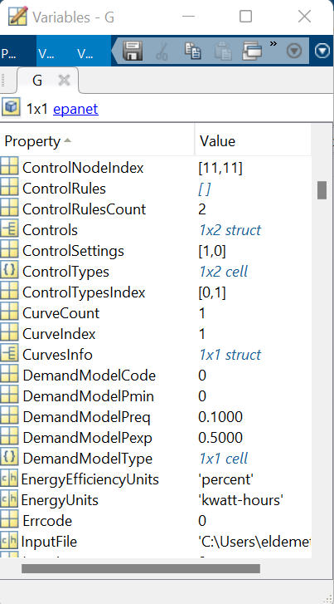
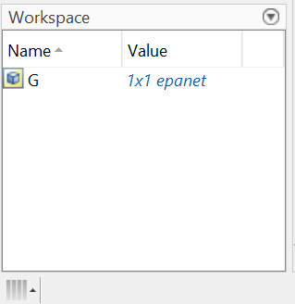
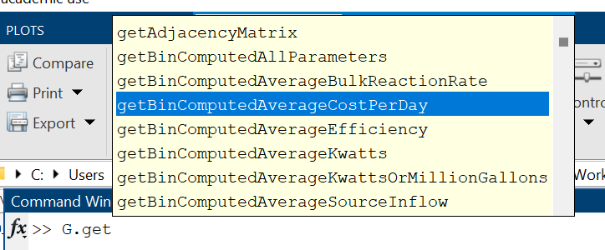
An epanet MATLAB Object
G has
799 methods (functions)
363 properties (variables)

Slide 15
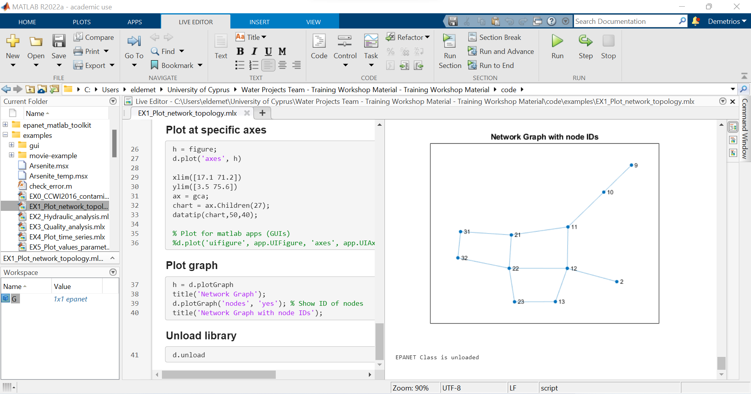
MATLAB and LiveScript
High-level programming environment
Large library of scientific methods (BSD license)
Live Editor for LiveScript (MLX)
Interactive execution of code – great for researchers!
Similar to Jupyter Notebooks for Python
Easy to communicate results & ideas

Slide 16
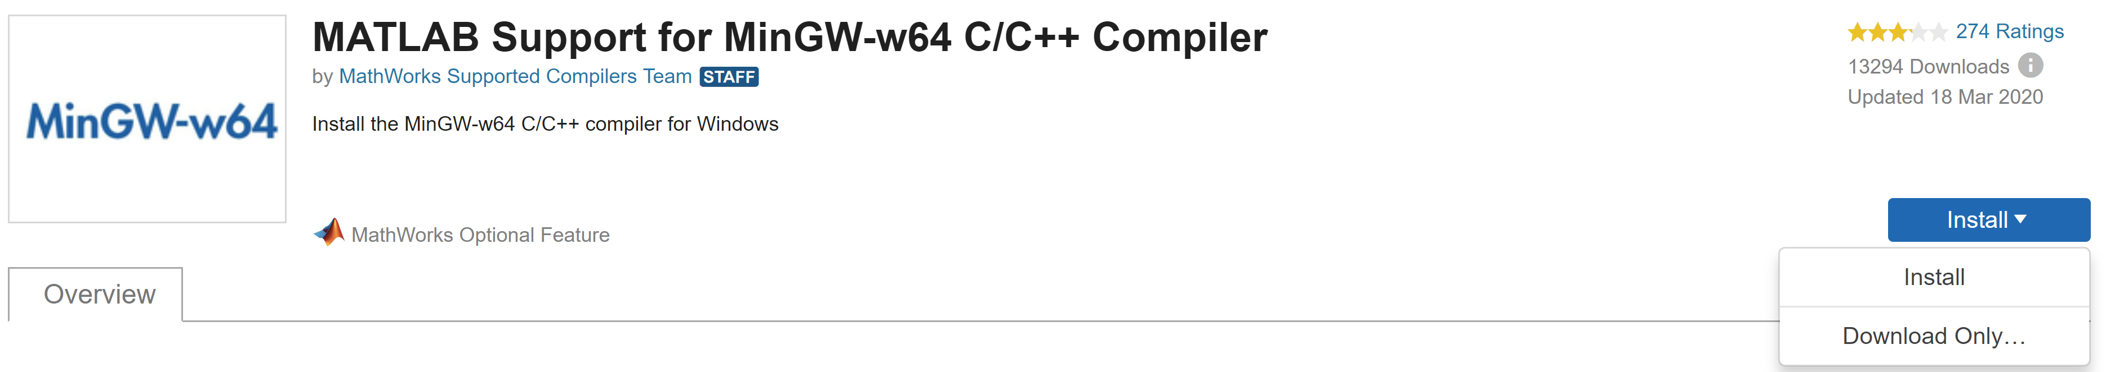
Prepare MATLAB for EMT
Windows
Install App “MinGW-w64 C/C++ Compiler”

Slide 17
Prepare MATLAB for EMT
Linux
Use gcc compiler
Copy “libepanet2.so” to the /lib/ folder (see guide)
macOS
Use Xcode with Clang compiler
To avoid security message, allow app “libepanet2.dylib”
Copy “libepanet2.dylib” to the /usr/local/lib folder

Slide 18
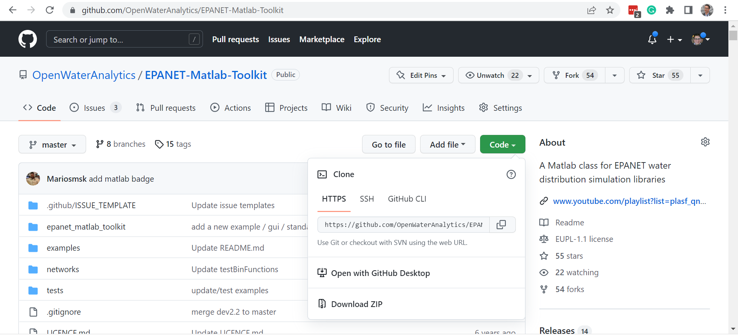
Quick start with EMT

Slide 19
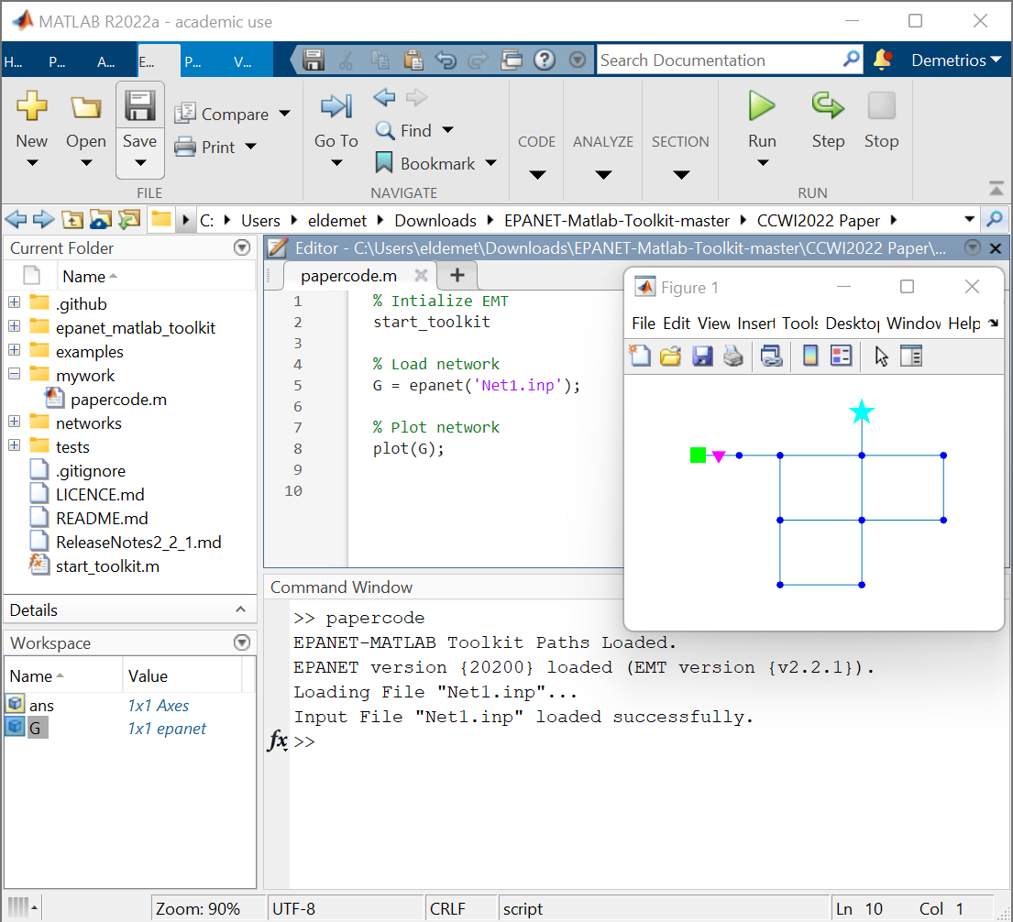
Quick start with EMT
Download & unzip
Copy files in your “work” folder (rename!)
Create a new folder “\mywork” and create an empty m or mlx file
Run “start_toolkit” to load toolkit in MATLAB

Slide 20

General Functionality

Slide 21
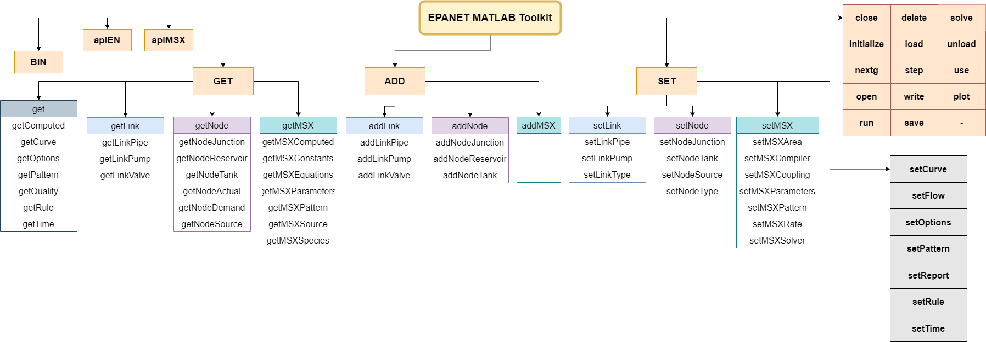
The epanet MATLAB CLass

Slide 22
Smart Water Networks Research

Slide 23
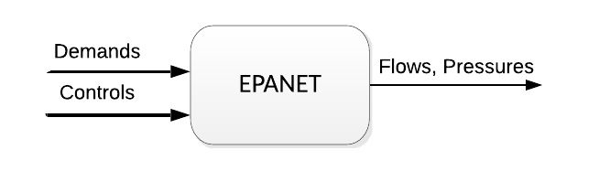
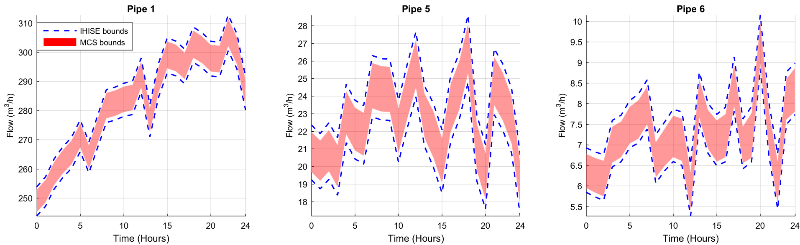
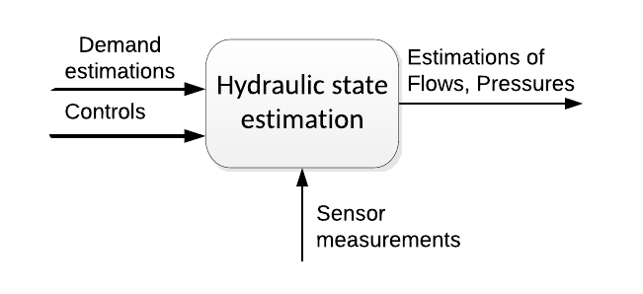
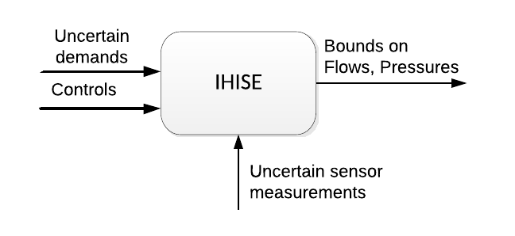
Hydraulic state estimation with uncertainty
Planning - offline
Real-time estimation
Real-time estimation considering uncertainty
Vrachimis, S. G.; Timotheou, S.; Eliades, D. G. & Polycarpou, M. M., Iterative Hydraulic Interval State Estimation for Water Distribution Networks, ASCE Journal of Water Resources Planning and Management, vol. 145, p. 04018087, 2018.

Slide 24
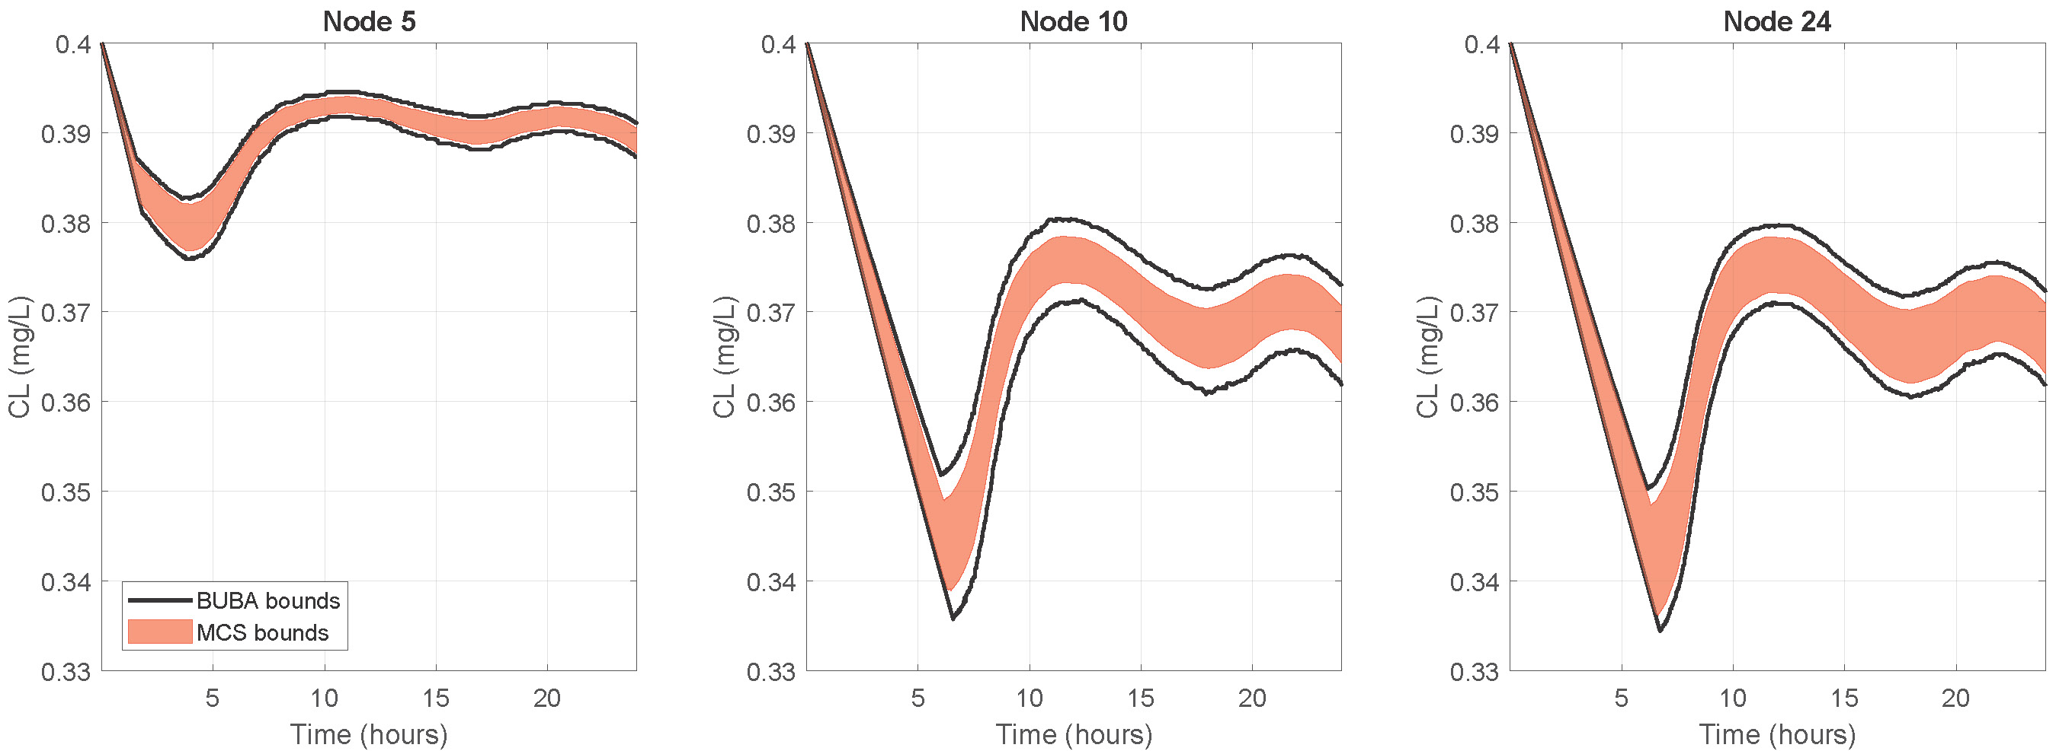
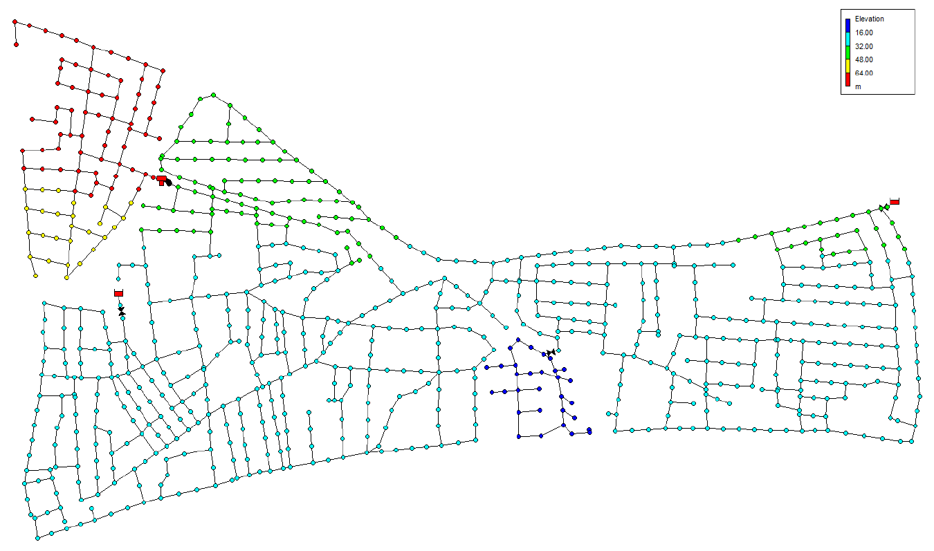
Estimating water quality considering uncertainty
The Backtracking Uncertainty Bounding Approach
Compute bounds of disinfectant concentrations in the network
Incorporates sensor measurements
Considers demand and reaction rate uncertainties
S. G. Vrachimis, D. G. Eliades, and M. M. Polycarpou, “Calculating Chlorine Concentration Bounds in Water Distribution Networks: A Backtracking Uncertainty‐Bounding Approach,” Water Resources Research, p. e2020WR028684, Mar. 2021.
24

Slide 25
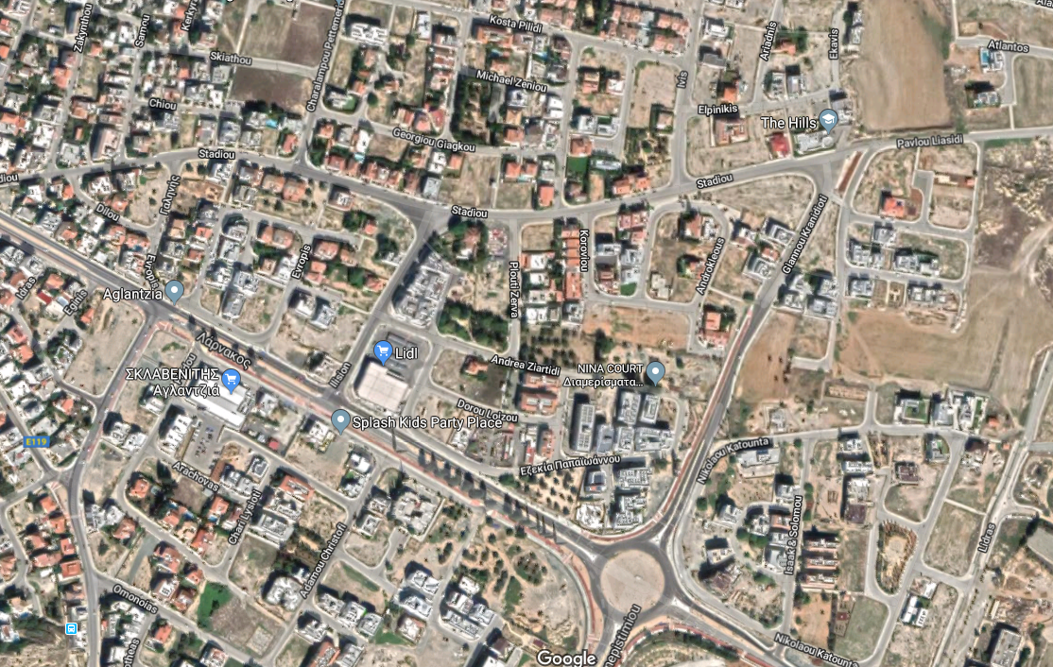
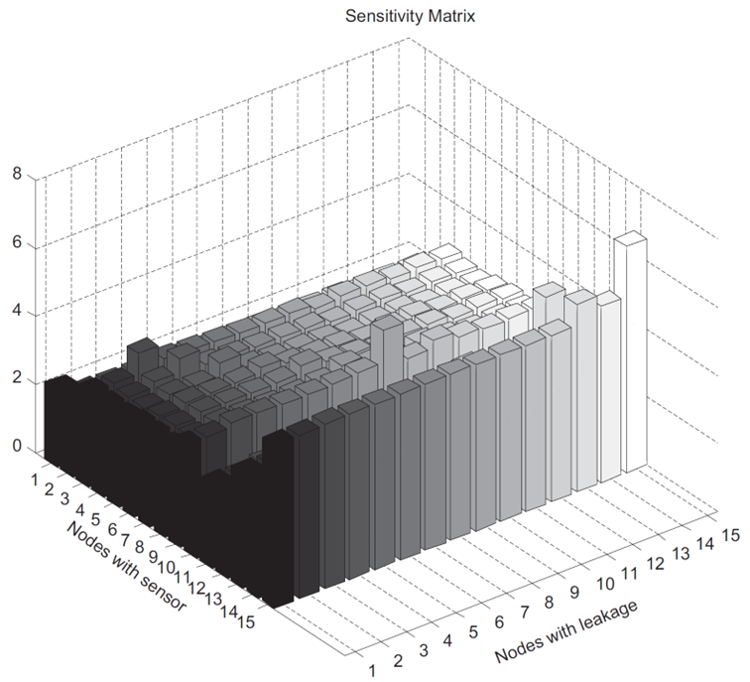
Pressure sensor placement
Challenges
Hundreds of states, only a few sensors
Objectives
Sensitivity of sensors to leakages
Minimize estimation uncertainty
Constraints
Feasible locations
Number of sensors
Detectability, isolability indices
Tools
Pressure sensitivity matrix
S
S
M. À. Cugueró-Escofet, V. Puig, and J. Quevedo, “Optimal pressure sensor placement and assessment for leak location using a relaxed isolation index: Application to the Barcelona water network,” Control Engineering Practice, vol. 63, pp. 1–12, Jun. 2017.

Slide 26
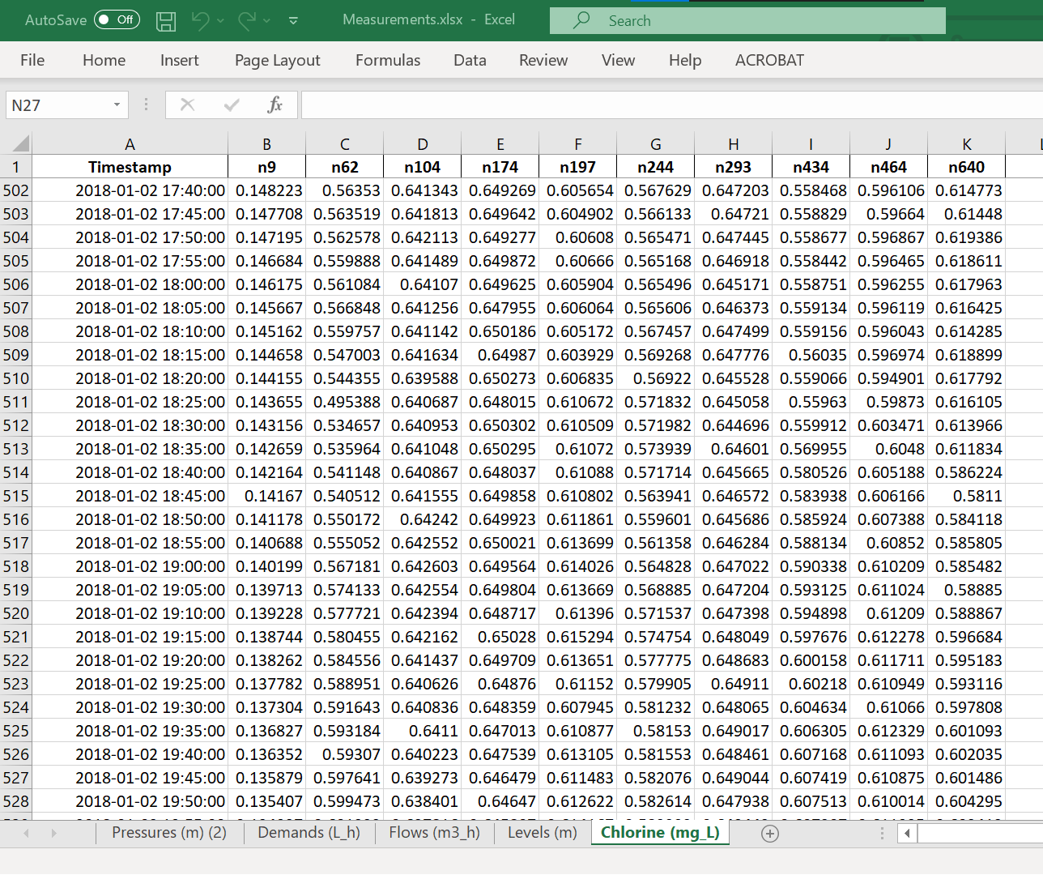
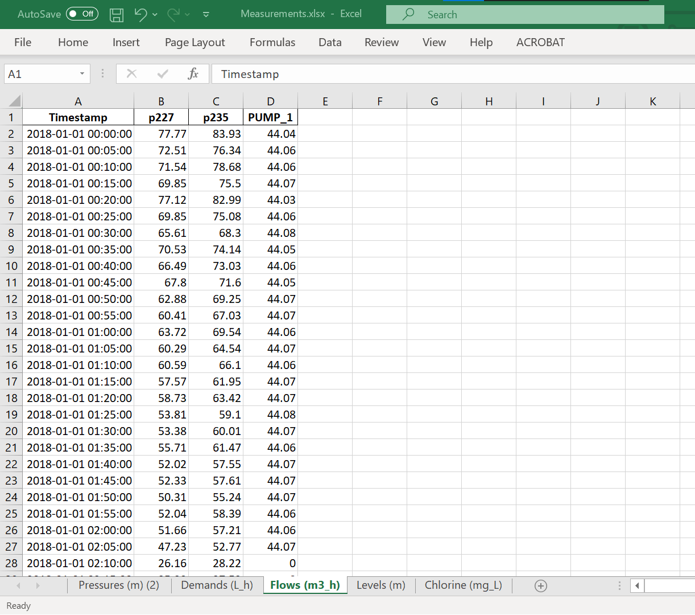
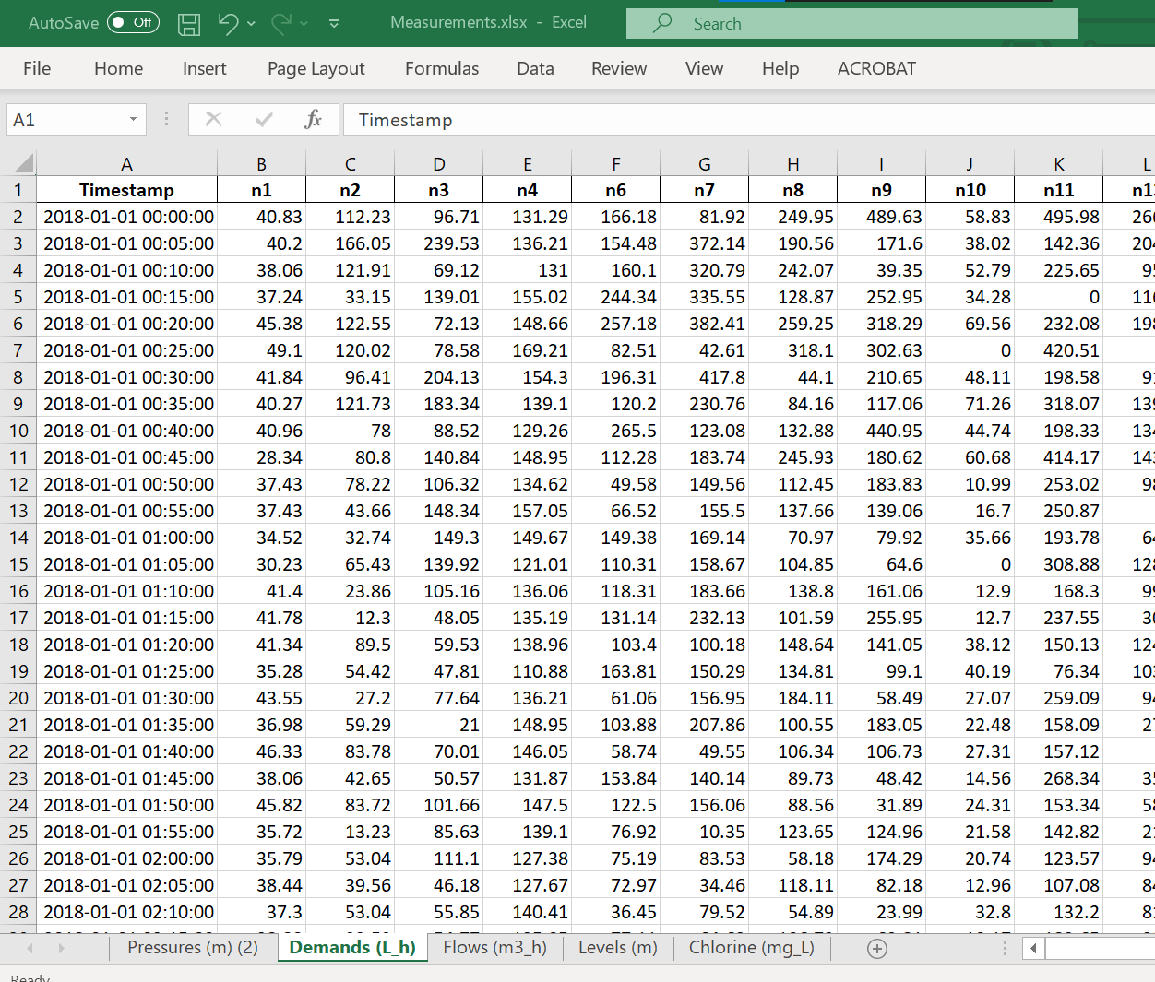
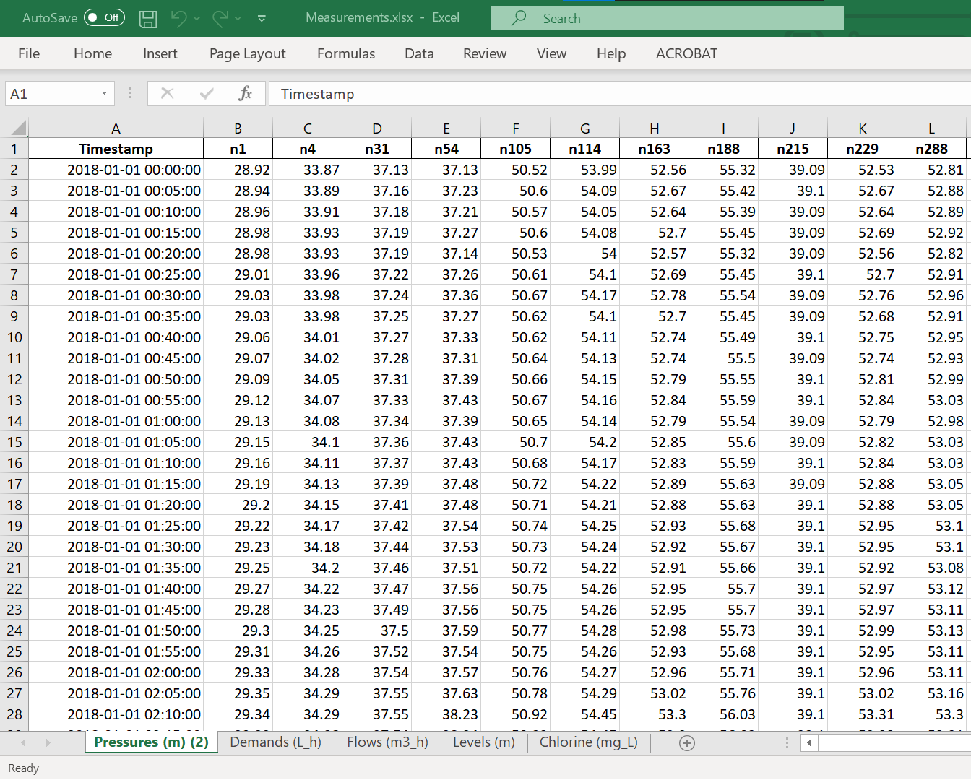
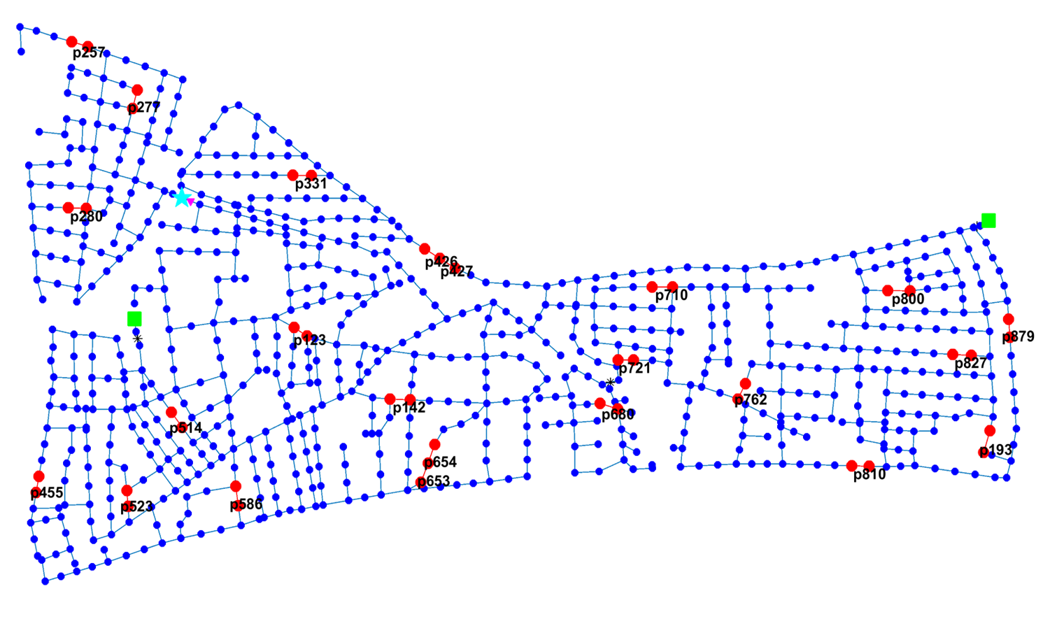
Leakage simulation and detection
BattLeDIM – Battle of the Leakage Detection and Isolation Methods
Realistic 2-year simulated SCADA dataset with leakages
L-TOWN – a benchmark network based on a real city
How to simulate realistic leakages?
How to detect a leakage?
How to localize the leak?
Leakage locations in the Battle of Leakage Detection and Isolation Methods (BATTLEDIM)
S. G. Vrachimis, D. G. Eliades, R. Taormina, Z. Kapelan, A. Ostfeld, S. Liu, M. Kyriakou, P. Pavlou, M. Qiu, and M. M. Polycarpou, “Battle of the Leakage Detection and Isolation Methods,” Journal of Water Resources Planning and Management, (Forthcoming) 2022.

Slide 27
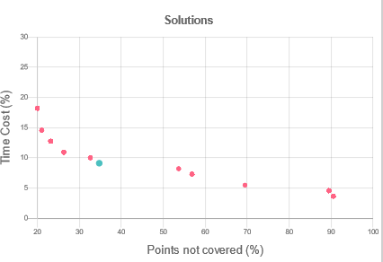
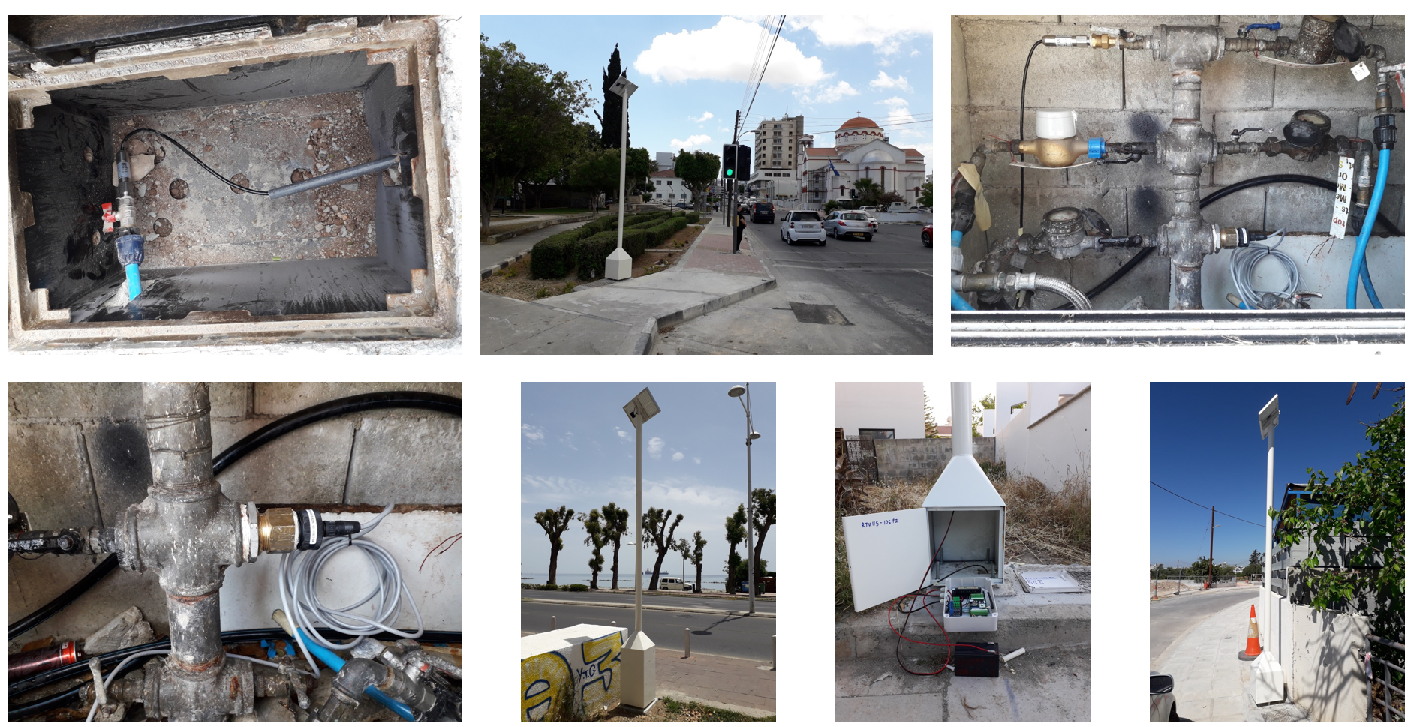
Water quality sensor placement
Multi-objective problem:
Minimize contamination impact
Minimize detection delay
Risk-based impact metrics
Challenging problem:
For 5 water quality sensors→ 10¹² solutions
Worst
solutions
Best
solutions
Eliades, Demetrios G., and Marios M. Polycarpou. "A fault diagnosis and security framework for water systems." IEEE Transactions on Control Systems Technology 18.6 (2009): 1254-1265.

Slide 28
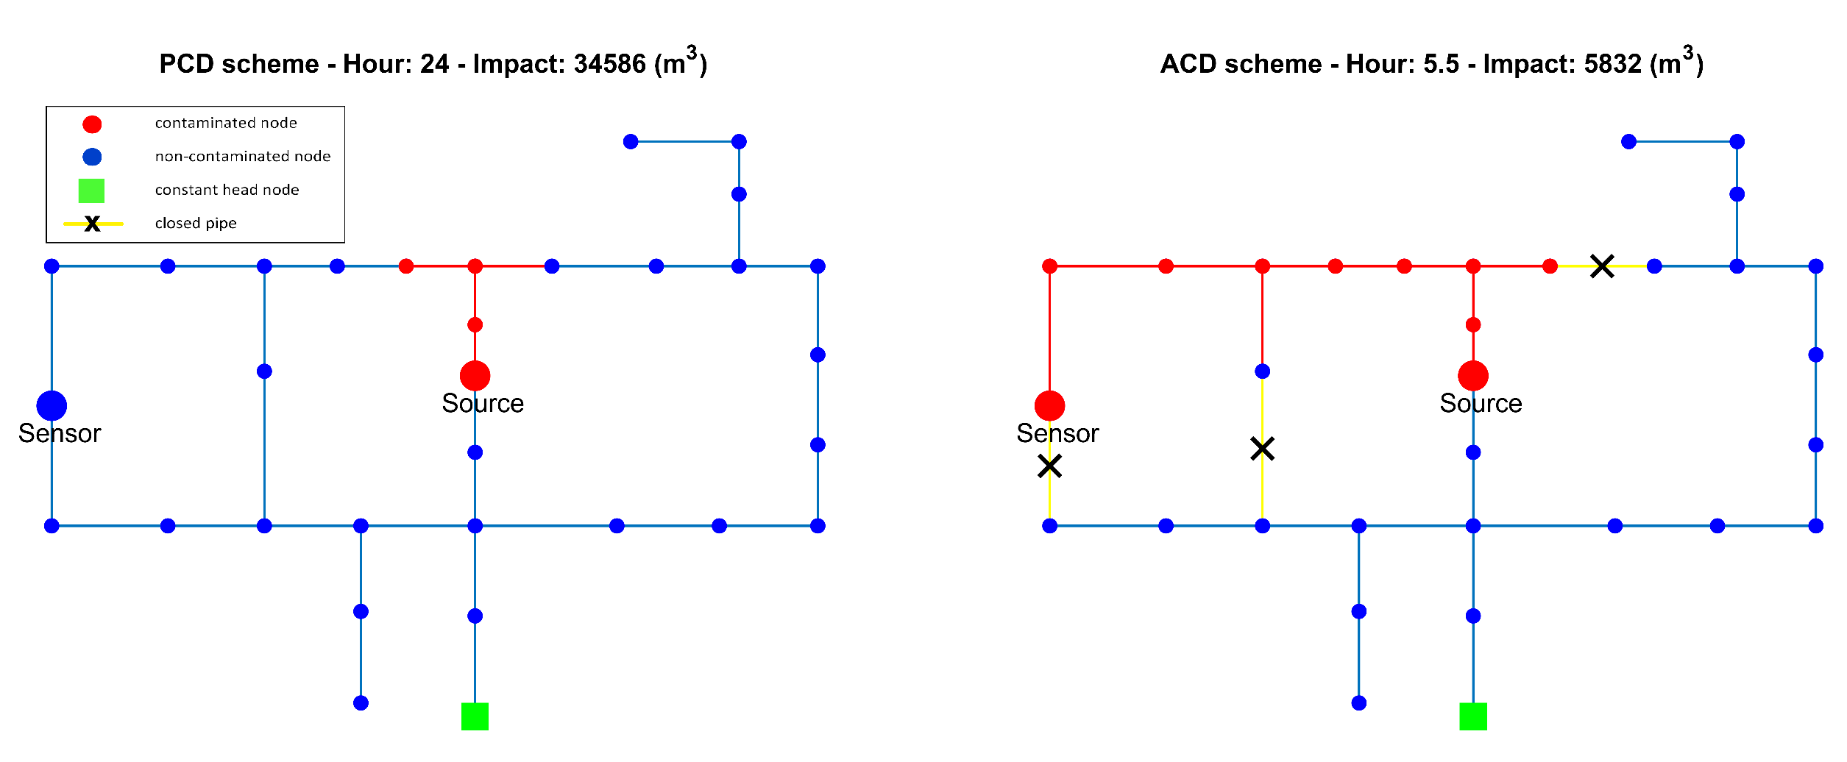
Active contamination detection
*Confirm a contamination by driving the contaminant to a sensor
S. G. Vrachimis, R. Lifshitz, D. G. Eliades, M. M. Polycarpou, and A. Ostfeld, “Active Contamination Detection in Water-Distribution Systems,” Journal of Water Resources Planning and Management, vol. 146, no. 4, p. 04020014, Apr. 2020.

Slide 29
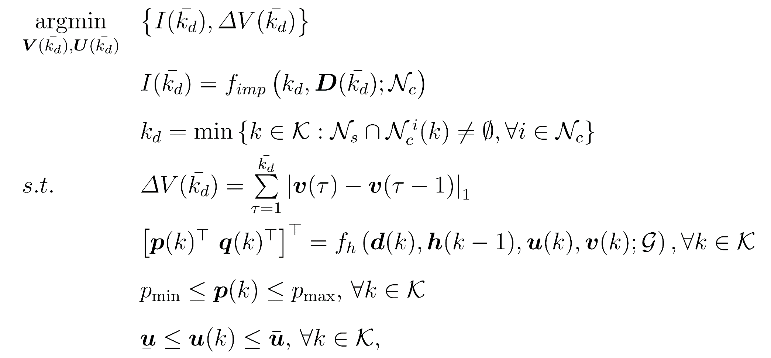
Active contamination detection
Contamination Impact
Number of
valve changes
Contamination Impact:
Detection Time:
Constraints:
Hydraulics
Pressure
Inputs
S. G. Vrachimis, R. Lifshitz, D. G. Eliades, M. M. Polycarpou, and A. Ostfeld, “Active Contamination Detection in Water-Distribution Systems,” Journal of Water Resources Planning and Management, vol. 146, no. 4, p. 04020014, 2020.

Slide 30
In this tutorial
How to include uncertainties in simulations
How to place pressure sensors
How to create and detect leakage events
How to place quality sensors
How to create and detect contamination events (using MSX)
Network graph theory for contamination analysis

Slide 31
Advanced topics

Slide 32
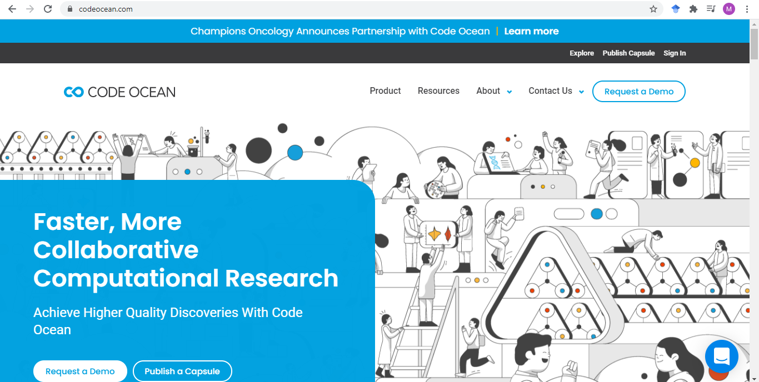
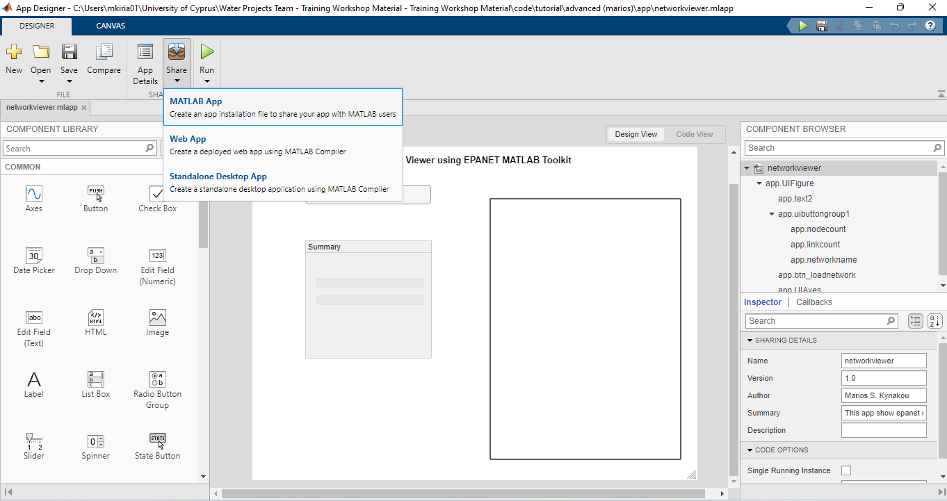
Topics
How to use GitHub
How to create an App
How to publish reproducible research on CodeOcean
How to create an EPANET animation

Slide 33
Useful links
EPANET Community: https://www.facebook.com/groups/302699687774783
OWA Forum: http://community.wateranalytics.org/

